Slide 1
Create a complete Tor Onion Service with Docker and OpenSUSE in less than
15 minutes
Jason S. Evans
Training Engineer, SUSE
jevans@suse.com

Slide 2
What is Tor?
Tor is free software and an open network that helps you defend against traffic analysis, a form of network surveillance that threatens personal freedom and privacy, confidential business activities and relationships, and state security.

Slide 3
How does Tor work?

Slide 4
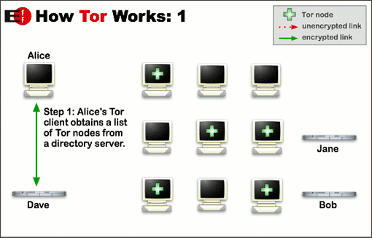

Slide 5
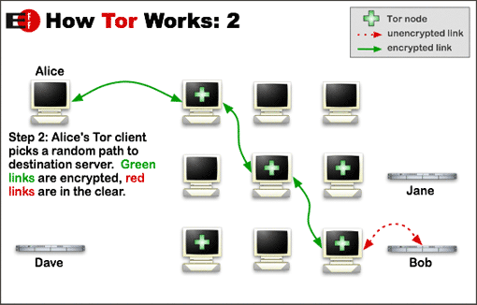

Slide 6
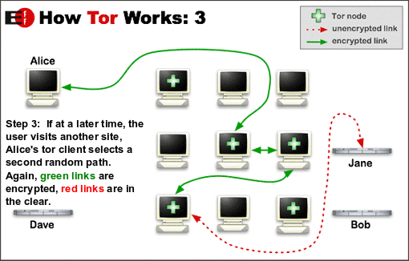

Slide 7
What isn’t Tor?

Slide 8
THE DARK WEB

Slide 9
Tor is a security and privacy network

Slide 10
It is used by...
Normal People
Journalists
Activists and Whistleblowers
Bloggers
Law Enforcement
Business Executives
Militaries
IT Professionals
https://www.torproject.org/about/torusers.html.en

Slide 11
But it has problems

Slide 12
Bad neighbors
Bad reputation
Slow

Slide 13
Help change the face of the Tor network
Encourage security and privacy advocates and users to harness the power of the network.
Encourage non-profits to mirror their websites on Tor.
Build your own onion service!

Slide 14
How do containers fit into all of this?

Slide 15
How are .onion services made?

Slide 16
The old way
Bob wants to build an onion service.
He’s got a website already, but wants it to be available on Tor.
This is to protect the privacy of his users.
He installs the tor service … zypper in tor
He edits his /etc/torrc file and tells it to listen on port 80.
He starts the service.
He finds his new .onion hostname in /var/lib/tor/hostname
garyxyzabc.onion

Slide 17

The new way
Geeko wants to build an onion service.
He’s very protective of his privacy.
But he has ideas and information that he would like to share with the world.
He creates a web container and attaches it to a tor container.
He never opens port 80, 443, or any other port locally that could be used locally to get to his website.
He finds his new .onion hostname in /var/lib/tor/hostname in the tor container.
geekoabcxyz.onion

Slide 18
Accessing onion services
Alice hears about Bob’s and Geeko’s websites.
She installs the Tor Browser
zypper in torbrowser-launcher
She puts in the onion url like any other.
Neither Bob nor Geeko ever see who she is or any other information that she doesn’t want to give.
She doesn’t know who Geeko is because he doesn’t explicitly say and there’s no easy way to find out.
She appreciates that she can view Bob’s website securely and without fear of being monitored.

Slide 19
What are Docker containers?
A container image is a lightweight, stand-alone, executable package of a piece of software that includes everything needed to run it: code, runtime, system tools, system libraries, settings.
https://www.docker.com/what-container

Slide 20
How does this approach help us?
It’s easy to run several onion services at once.
You don’t have to know how to set up the individual pieces.
You focus on content and not on administration.

Slide 21
Demonstation

Slide 22
How will we use containers today?
We will use 3 containers.
The first will be the web server containing Apache and Wordpress
The second will be the MySQL database
The third will be running Tor.

Slide 23
Demonstation
For our demonstration, I will be using Docker images to create the containers and the docker-compose command to set everything up quickly and easily. Using these steps, you can replicate this example website on your own.

Slide 24
Install the necessary packages
The dependancies will pull in everything that you need.
zypper in docker-compose git

Slide 25
Download the docker-compose file
git clone https://github.com/tgeek77/openSUSECon-tor.git

Slide 26
Our docker-compose file
version: "2"
services:
tor:
image: goldy/tor-hidden-service:latest
links:
- wordpress
restart: always
# Keep keys in volumes
volumes:
- ./tor:/var/lib/tor/hidden_service
environment:
# Set mapping ports
WORDPRESS_PORTS: "80:80"

Slide 27
db:
image: mariadb
restart: always
environment:
MYSQL_ROOT_PASSWORD: rootpass
MYSQL_DATABASE: wordpress
MYSQL_USER: wordpress
MYSQL_PASSWORD: wordpress123
volumes:
- ./mysql:/var/lib/mysql

Slide 28
wordpress:
depends_on:
- db
image: wordpress:latest
links:
- db
restart: always
environment:
WORDPRESS_DB_HOST: db:3306
WORDPRESS_DB_USER: wordpress
WORDPRESS_DB_PASSWORD: wordpress123

Slide 29
Start the containers
docker-compose up -d

